Slide 1
Checking and further securing understanding of the commutative law
Standard form

Slide 2
How our teaching resources are designed for the classroom

Slide 3
I can state the commutative law and use it to calculate efficiently.

Slide 4

When a number is multiplied by itself multiple times, it can be written more simply in exponential form.
e.g.
e.g.

Slide 5
An operation is commutative if the values it is operating on can be written in either order without changing the calculation.
Example
Example
Non example
3 + 4 =
4 + 3
7 ✕ 2 =
2 ✕ 7
10 − 2 ≠
2 − 10

Slide 6
A prime number is an integer greater than one with exactly 2 factors. All integers greater than 1 are either composite or prime.
Prime factors are the factors of a number that are, themselves, prime.
Prime factorisation is a method to find the prime factors of a given integer.

Slide 7

Checking and further securing understanding of the commutative law
Reviewing product of prime factors
Using product of prime factors

Slide 8



Reviewing product of prime factors
Sofia and Alex have been practising writing numbers as a unique product of their prime factors.
600 written as a product of its prime factors is
2 × 2 × 2 × 3 × 5 × 5
600 written as a product of its prime factors is
2³ × 3 × 5²
Who is right?
They are both right.
Alex has written his using index notation.
Sofia
Alex

Slide 9

Reviewing product of prime factors
Index notation is when we write a repeated multiplication using a base and exponent.
The exponent is 4
This means
The base is 7
7 ✕ 7 ✕ 7 ✕ 7

Slide 10

Reviewing product of prime factors
Which of the following shows 2 × 2 × 3 × 3 × 3 × 5 × 7 written correctly using index notation?
2² × 3³ × 35
2³ × 3³ × 5 × 7
2² × 3³ × 5 × 7

Slide 11
Reviewing product of prime factors
Write 1260 as a product of prime factors
1260
= 126 × 10
= 2 × 63 × 2 × 5
= 2 × 7 × 9 × 2 × 5
= 2 × 7 × 3 × 3 × 2 × 5
= 2 × 2 × 3 × 3 × 5 × 7
= 2² × 3² × 5 × 7

Slide 12
Reviewing product of prime factors
Write 250 as a product of its prime factors.
Write 360 as a product of its prime factors.
250
= 25 × 10
360
= 36 × 10
= 5 × 5 × 2 × 5
= 6 × 6 × 2 × 5
= 2 × 5³
= 2 × 3 × 2 × 3 × 2 × 5
= 2³ × 3² × 5

Slide 13
Reviewing product of prime factors
360 = 2³ × 3² × 5
We can use this to write other numbers as a product of their prime factors without repeating the process from the beginning.
720
= 360 × 2
3600
= 360 × 10
= 2³ × 3² × 5
× 2
= 2³ × 3² × 5
× 2 × 5
= 2⁴ × 3² × 5
= 2⁴ × 3² × 5²

Slide 14
Reviewing product of prime factors
Which three numbers can be found more easily using 120 written as a product of its prime factors?
2400
480
90
360

Slide 15
Reviewing product of prime factors
Let’s try a couple more:
450 = 2 × 3² × 5²
1800
= 450 × 4
= 2 × 3² × 5²
× 2²
= 2 × 2² × 3² × 5²
= 2³ × 3² × 5²
1800 written as a product of its prime factors is 2³ × 3² × 5²

Slide 16
Reviewing product of prime factors
Let’s try a couple more:
450 = 2 × 3² × 5²
150
= 450 ÷ 3
= 2 × 3² × 5²
÷ 3
= 2 × 3² ÷ 3 × 5²
= 2 × 3 × 5²
150 written as a product of its prime factors is 2 × 3 × 5²

Slide 17
Reviewing product of prime factors
Using 225 = 3² × 5² write 900 as a product of its prime factors.
900
= 225 × 4
= 3² × 5²
× 2²
= 2² × 3² × 5²
900 written as a product of its prime factors is 2² × 3² × 5²

Slide 18
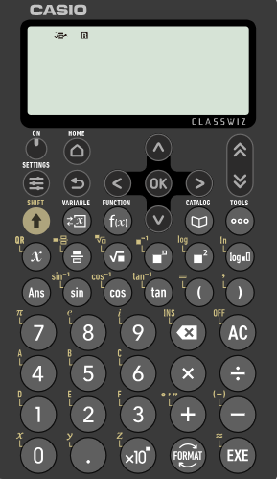
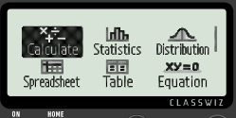

Reviewing product of prime factors
We can use also use scientific calculators to check the prime factor decomposition of a number.
Here is the Casio fx-991EX.
Firstly, ensure ‘Calculate’ is highlighted.
Then press ‘EXE’

Slide 19
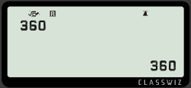
Reviewing product of prime factors
Let’s check the prime factor decomposition of 360
Type in 360 and press ‘EXE’

Slide 20
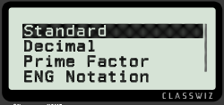

Reviewing product of prime factors
Let’s check the prime factor decomposition of 360
Type in 360 and press ‘EXE’
Then select ‘FORMAT’

Slide 21
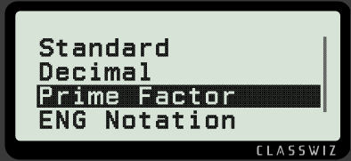

Reviewing product of prime factors
Scroll down until ‘Prime Factor’ is highlighted.
Then press ‘EXE’ again

Slide 22
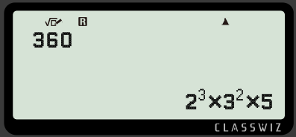
Reviewing product of prime factors
This will reveal the number as a product of its prime factors.
360 = 2³ × 3² × 5

Slide 23
Reviewing product of prime factors
1) Write the following as a product of prime factors, without using a calculator.
a) 200
b) 196
c) 378
d) 308
e) 23 400

Slide 24
Reviewing product of prime factors
2) Use 60 = 2² × 3 × 5 to write the following, without using a calculator, as a product of prime factors.
a) 120
b) 180
c) 300
d) 600
e) 6000
f) 4200
g) 30

Slide 25
Reviewing product of prime factors
1) Write the following as a product of prime factors, without using a calculator.
a) 200
b) 196
c) 378
d) 308
e) 23 400
2³ × 5²
2² × 7²
2 × 3³ × 7
2² × 7 × 11
2³ × 3² × 5²× 13

Slide 26
Reviewing product of prime factors
2) Use 60 = 2² × 3 × 5 to write the following, without using a calculator, as a product of prime factors.
a) 120
b) 180
c) 300
d) 600
e) 6000
f) 4200
g) 30
= 60 × 2 = 2² × 3 × 5 × 2 = 2³ × 3 × 5
= 60 × 3 = 2² × 3 × 5 × 3 = 2² × 3² × 5
= 60 × 5 = 2² × 3 × 5 × 5 = 2² × 3 × 5²
= 60 × 10 = 2² × 3 × 5 × 2 × 5 = 2³ × 3 × 5²
= 60 × 100 = 2² × 3 × 5 × 2² × 5² = 2⁴ × 3 × 5³
= 60 × 70 = 2² × 3 × 5 × 7 × 10 = 2² × 3 × 5 × 7 × 2 × 5
= 2³ × 3 × 5² × 7
= 60 ÷ 2 = 2² × 3 × 5 ÷ 2 = 2 × 3 × 5

Slide 27
Checking and further securing understanding of the commutative law
Reviewing product of prime factors
Using product of prime factors

Slide 28


Using product of prime factors
Laura and Jacob are talking about how to calculate 35 × 22
Can we use products of prime factors to make calculating this easier?
We could as they are both products. But, does it make it easier?
Laura
Jacob
What do you think?
Let’s take a look.

Slide 29
Using product of prime factors
35 and 22 written as a product of their prime factors:
35 = 5 × 7
22 = 2 × 11
35 × 22 = 5 × 7 × 2 × 11
35 × 22 = 5 × 2 × 7 × 11
35 × 22 = 10 × 77
35 × 22 = 770
We can rearrange this calculation using the commutative law.
It’s going to be best to pair the 2 and 5 as the product of those is 10
I wonder if it will always make the calculation easier.
That definitely made that calculation easier.
Laura
Jacob

Slide 30
Using product of prime factors
Can writing 105 and 231 as a product of prime factors make this following calculation easier: 105 × 231 ?
105 = 5 × 21
= 5 × 3 × 7
231 = 3 × 77
= 3 × 7 × 11
105 × 231 = 5 × 3 × 7 × 3 × 7 × 11
I cannot see any pairs that are going to make this calculation easier.
Jacob

Slide 31
Using product of prime factors
Let’s take a look at the prime numbers we are most likely to see and decide which pairs will be useful for making a calculation easier.
Can you remember the first 8 prime numbers?
2, 3, 5, 7, 11, 13, 17, 19, …
Oh yes, and an easy way to multiply by 9 is to multiply by 10 and subtract one of the values.
It looks to me like 2 and 5 are the only useful pair.
Maybe if there were 2 threes, that could be useful as the product of those is 9
Laura
Jacob

Slide 32
Using product of prime factors
Calculate 33 × 21
33 = 3 × 11
21 = 3 × 7
33 × 21 = 3 × 11 × 3 × 7
rearrange using the commutative law
33 × 21 = 3 × 3 × 11 × 7
33 × 21 = 9 × 77
= 10 × 77 − 1 × 77
= 770 − 77
= 693

Slide 33
Using product of prime factors
Calculate 42 × 75 using prime factors.
42 = 2 × 21
= 2 × 3 × 7
75 = 3 × 25
= 3 × 5 × 5
42 × 75 = 2 × 3 × 7 × 3 × 5 × 5
rearrange using the commutative law
42 × 75 = 2 × 5 × 3 × 3 × 7 × 5
= 10 × 9 × 35
= 10 × (10 × 35 − 1 × 35)
= 10 × (350 − 35)
= 10 × 315 = 3150

Slide 34
Using product of prime factors
Calculate 36 × 175 using prime factors.
36 = 2² × 3²
175 = 5² × 7
36 × 175 = 2² × 3² × 5² × 7
= 2 × 2 × 3 × 3 × 5 × 5 × 7
= 2 × 5 × 2 × 5 × 3 × 3 × 7
= 10 × 10 × 9 × 7
= 100 × 63
= 6300

Slide 35
Using product of prime factors
42 = 2 × 3 × 7 308 = 2² × 7 × 11 35 = 5 × 7
195 = 3 × 5 × 13 90 = 2 × 3² × 5 198 = 2 × 3² × 11
1) Use the prime factors above to calculate the following:
a) 42 × 90
b) 198 × 42
c) 198 × 35
d) 90 × 308
e) 195 × 198

Slide 36
Using product of prime factors
42 = 2 × 3 × 7 308 = 2² × 7 × 11 35 = 5 × 7
195 = 3 × 5 × 13 90 = 2 × 3² × 5 198 = 2 × 3² × 11
1) Use the prime factors above to calculate the following:
a) 42 × 90
b) 198 × 42
c) 198 × 35
d) 90 × 308
e) 195 × 198
3780
8316
6930
27 720
38 610

Slide 37
Checking and further securing understanding of the commutative law
All composite numbers can be written as a unique product of prime factors. E.g.
Products of prime factors can be written more efficiently using index notation. E.g.
The commutative law and prime factors can be used to make finding products easier when calculating mentally.
52
= 2 × 26
= 2 × 2 × 13
52
= 2² × 13

Slide 38

© Oak National Academy 2024.
Produced in partnership with Mathematics in Education and Industry.
Licensed on the Open Government Licence v3.0, except where otherwise stated. See Oak terms and conditions.

